Slide 1
Organization Overview
Presented by: Amy Trang, Ph.D., M.Ed.
April 5, 2021

Slide 2
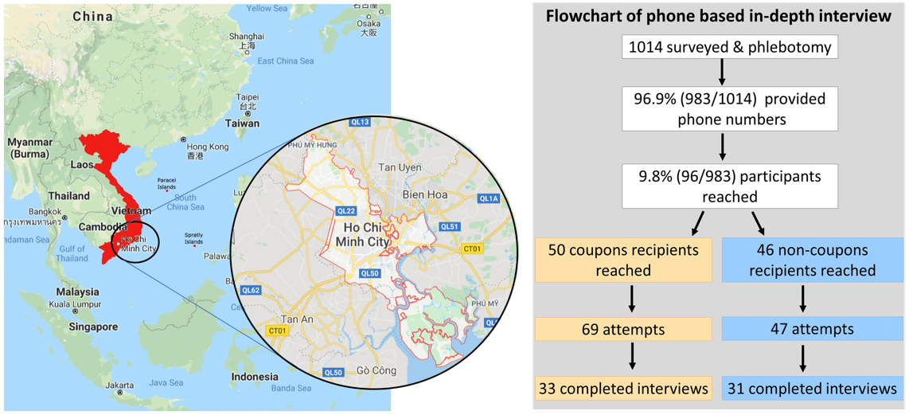
Vision: Viral Hepatitis Elimination in Vietnam by 2030
Mission:
Stimulate and facilitate the design, funding, and implementation of high-impact public health initiatives in Vietnam to deal decisively with the huge and pressing problems of hepatitis B and C.

Slide 3
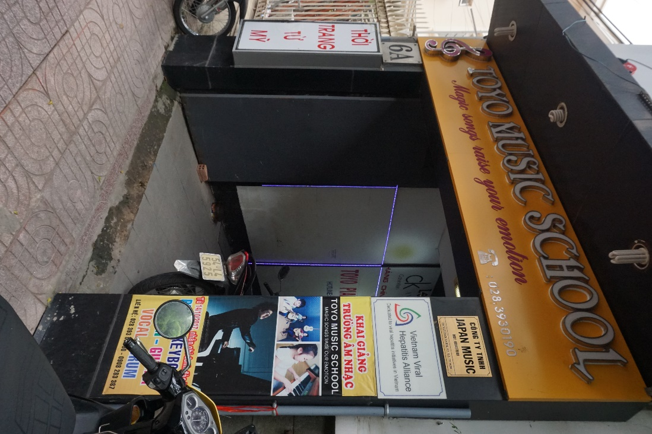
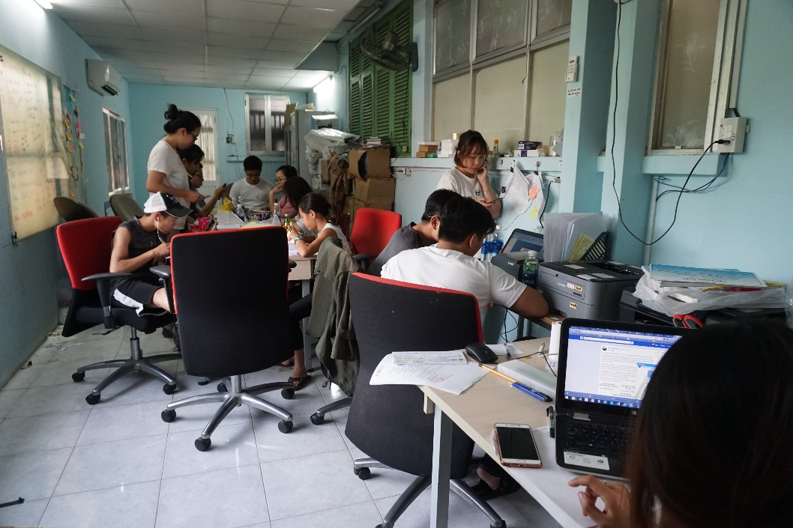
6A Ngo Thoi Nhiem, Ward 7, District 3, Ho Chi Minh City (Vietnam Office)

Slide 4
Strategic partners
International
World Health Organization (WHO) Vietnam Office
U.S. Centers for Disease Control and Prevention (CDC) Vietnam Office
Coalition for Global Hepatitis Elimination (Task Force for Global Health)
World Hepatitis Alliance (WHA)
Coalition to Eradicate Viral Hepatitis in Asia Pacific (CEVHAP)
Hepatitis B Foundation
Gilead Sciences
Roche Diagnostics
AbbVie
Abbot
Reliv
Local
HCMC Health Department (public / government)
Pham Ngoc Thach University School of Medicine (public)
HCMC Open University (public)
Medic Medical Center (private)
National
Vietnam Ministry of Health (public / government)
Vietnam Red Cross Society (NGO)
This Photo by Unknown Author is licensed under CC BY-SA

Slide 5
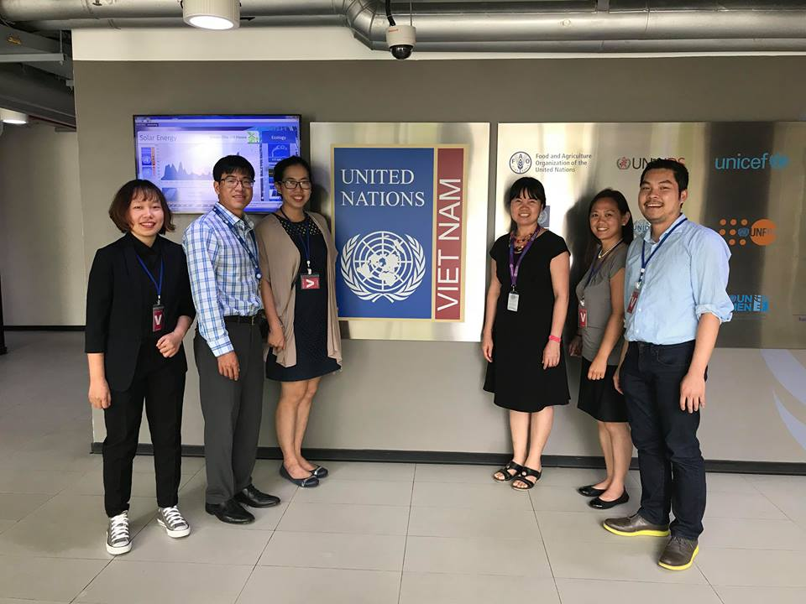
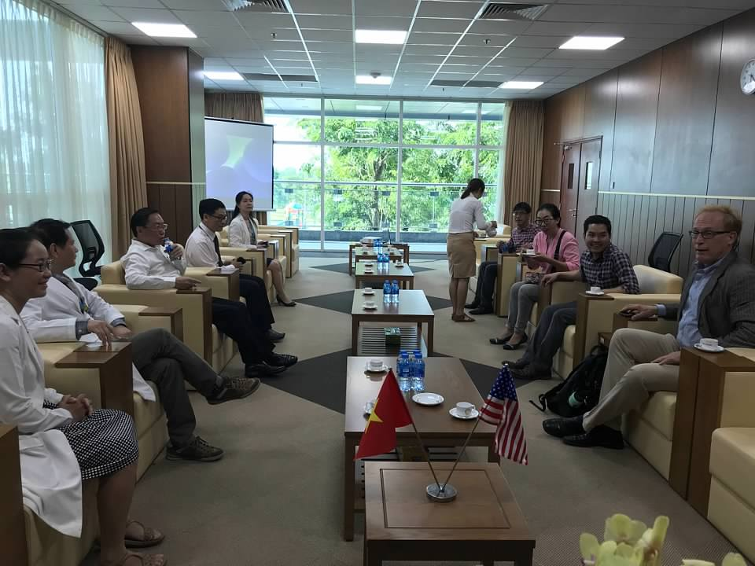
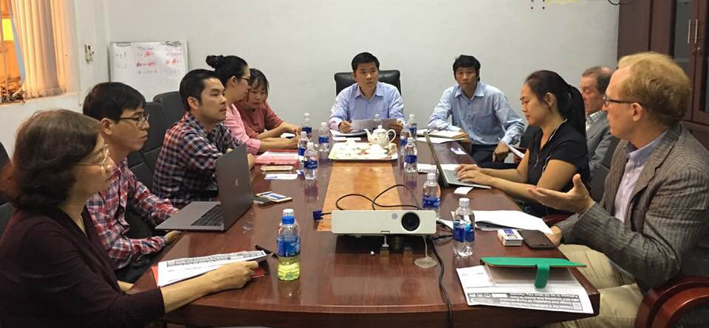
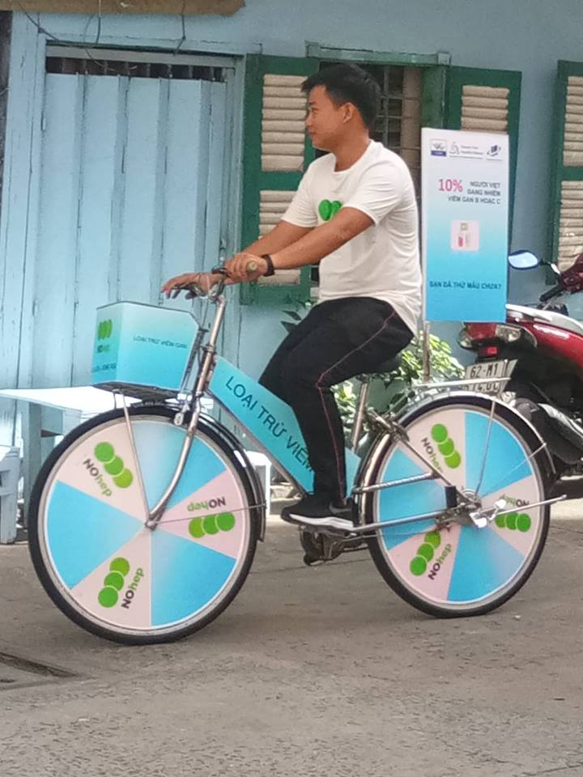
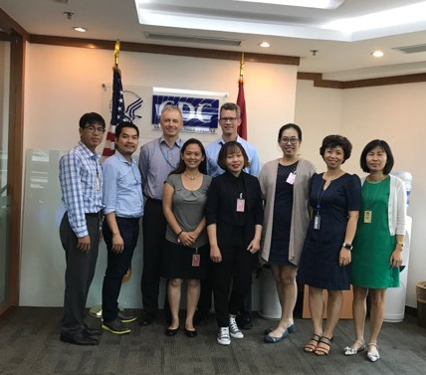
Key Stakeholders

Slide 6
Milestones
Program components:
Prevalence and surveillance study of hepatitis B and C in Ho Chi Minh City (HCMC)
International conferences to discuss the latest research and developments pertaining to viral hepatitis and liver diseases
Post-screening linkage to care program called Pathways for Access to Hepatitis Treatment (P.A.T.H.) to Cure in Vietnam
Health Education for Liver Professionals (H.E.L.P.) in Viral Hepatitis for Vietnam
Screening and provisions of access to care for viral hepatitis among health care professionals in HCMC.
Hepatitis Evaluation to Amplify Testing and Treatment (H.E.A.T.) in Vietnam
Dec. 2014
Established in December 2014
June 2015
Received 501(c)3 tax-exempt public charity status in June 2015
July 2017
Granted international non- government organization (iNGO) status by Vietnam’s Department of State July 2017.
July 2018
Screening completion of 20,000 individuals in HCMC utilizing the probability proportional to sample size (PPS) methodology
August 2020
Single-day community screening of 2,000 individuals at the Reunification Palace (formerly Independence Palace) in HCMC for World Hepatitis Day

Slide 7
Overview of viral hepatitis burden in Vietnam
Source:
¹ CIA World Factbook. Source: https://www.cia.gov/the-world-factbook/countries/vietnam. Retreived 4/1/2021
² For both HCV and HBV estimates of disease burden are based on models using data from non-prospective and small-scale studies.
³ Cooke GS, Andrieux-Meyer I, Applegate TL, Atun R, Burry JR, Cheinquer H, et al. Accelerating the elimination of viral hepatitis: a Lancet Gastroenterology & Hepatology Commission. Lancet Gastroenterol Hepatol. 2019;4(2):135-84. Epub 2019/01/17. doi: 10.1016/S2468-1253(18)30270-X. PubMed PMID: 30647010.
⁴ Berto A, Day J, Van Vinh Chau N, Thwaites GE, My NN, Baker S, et al. Current challenges and possible solutions to improve access to care and treatment for hepatitis C infection in Vietnam: a systematic review. BMC Infect Dis. 2017;17(1):260. Epub 2017/04/13. doi: 10.1186/s12879-017-2360-6. PubMed PMID: 28399806; PubMed Central PMCID: PMCPMC5387342.
⁵ Van Thi Thuy Nguyen TDQ, Nguyen Thu Anh, Masaya Kato, Le Quang Tan, Le Linh-Vi, Homie Razavi, Tran Dac Phu. Estimates and projection of disease burden and investment case for hepatitis C in Viet Nam. Journal of Viral Hepatitis, Abstract P2-065. 2018. doi: https://doi.org/10.1111/jvh.187_12923.
⁶ Van Thi Thuy Nguyen TDQ, Nguyen Thu Anh, Masaya Kato, Le Quang Tan, Le Linh-Vi, Homie Razavi, Tran Dac Phu. Estimates and projection of disease burden and economic analysis for hepatitis B in Viet Nam. Journal of Viral Hepatitis, Abstract P1-011. 2018. doi: https://doi.org/10.1111/jvh.07_12923.
⁷ Le VQ, Nguyen VH, Nguyen VH, Nguyen TL, Sudenga SL, Trinh LH, et al. Epidemiological Characteristics of Advanced Hepatocellular Carcinoma in the Northern Region of Vietnam. Cancer Control. 2019;26(1):1073274819862793. Epub 2019/07/11. doi: 10.1177/1073274819862793. PubMed PMID: 31290350; PubMed Central PMCID: PMCPMC6620729.
⁸ Nguyen-Dinh SH, Do A, Pham TND, Dao DY, Nguy TN, Chen MS, Jr. High burden of hepatocellular carcinoma and viral hepatitis in Southern and Central Vietnam: Experience of a large tertiary referral center, 2010 to 2016. World J Hepatol. 2018;10(1):116-23. Epub 2018/02/06. doi: 10.4254/wjh.v10.i1.116. PubMed PMID: 29399285; PubMed Central PMCID: PMCPMC5787675.
Country population: 102,789,598 (July 2021 est.)¹
Key stats²:
13th highest national burden of viral hepatitis worldwide³.
HBV prevalence: 8.4% are chronic HBV carriers (estimated)⁶
Only 1.34% of those who are candidates for HBV therapy are on anti-viral therapy.
HCV prevalence: 1.1 % to 4.7% (estimated)⁴
In 2017, WHO’s Vietnam Office, Vietnam’s Ministry of Health, and Center for Disease Analysis Foundation, USA projected that, without intervention, 14,923 cases of HCV decompensated cirrhosis, 8,923 cases of HCV-linked cancer, and 7,123 occurrences of HCV related mortality will be reported in 2030 and will continue to rise thereafter.⁵
In 2018, primary hepatocellular carcinoma (HCC) surpassed lung cancer and became the leading cause of cancer-related death in Vietnam.⁷
Facility based studies reveal approximately 80% of HCC cases in Vietnam are associated with chronic HBV and/or HCV infection. For example, 24,091 cases of HCC were reported from Cho Ray Hospital, the largest tertiary hospital in HCMC. Of these, 25% and 62% were due to HCV and HBV, respectively⁸

Slide 8
HBV-HCV Cascade of Care Process
Planning: Obtain permission from local authorities for screening activities in the community. Confirm and secure screening sites.
Outreach & Education: Invite program participants by going door to door with letter hand delivered to their home, using the Probability Proportionate to Size sampling method.
Screening & Testing Day: Pre-screen participants before collecting blood samples for diagnosis.
Receive results for each site sampled. Review and verify by physician(s) before contacting program participants (patients)
Contact patients to share their results verbally and confirm mailing address to send the official results.
Refer and link patients who tested positive for HBV and/or HCV to care and treatment services. Patients who need hepatitis B vaccination will be referred for service. Provide education seminar opportunities.

Slide 9
Cornerstone Pilot Project
Project Year(s): 2016-2017
Project goal: to validate the feasibility of a large- scale program to determine the prevalence of hepatitis B and C in Ho Chi Minh City (HCMC), Vietnam utilizing the probability proportional to sample size (PPS) methodology
Project outcomes:
Screening of 2,000 individuals in HCMC
Access to health care and vaccinations were provided as appropriate
2-day CME conference for over 300 physicians during World Hepatitis Day 2016
1-day CME conference for over 500 physicians during World Hepatitis Day 2017
14-minute viral hepatitis program feature on Ho Chi Minh Television Channel 9 (HTV-9)

Slide 10
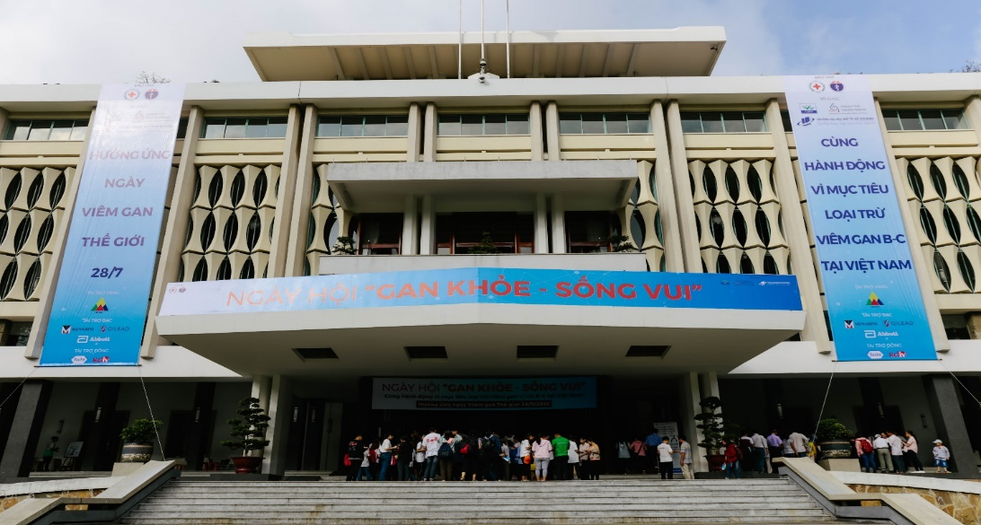
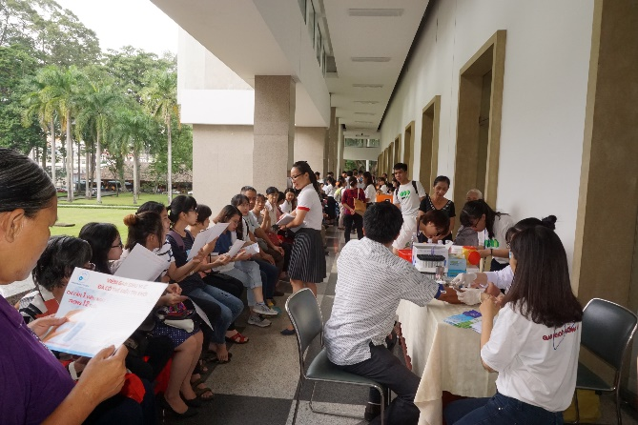
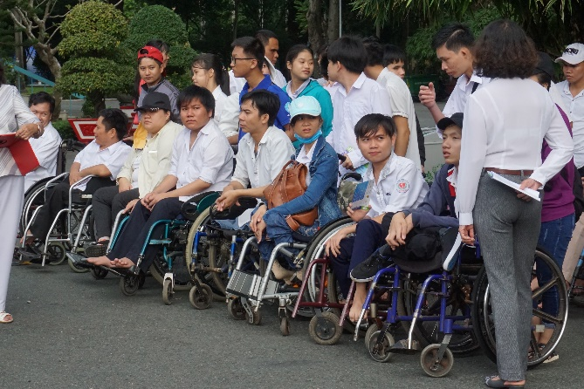
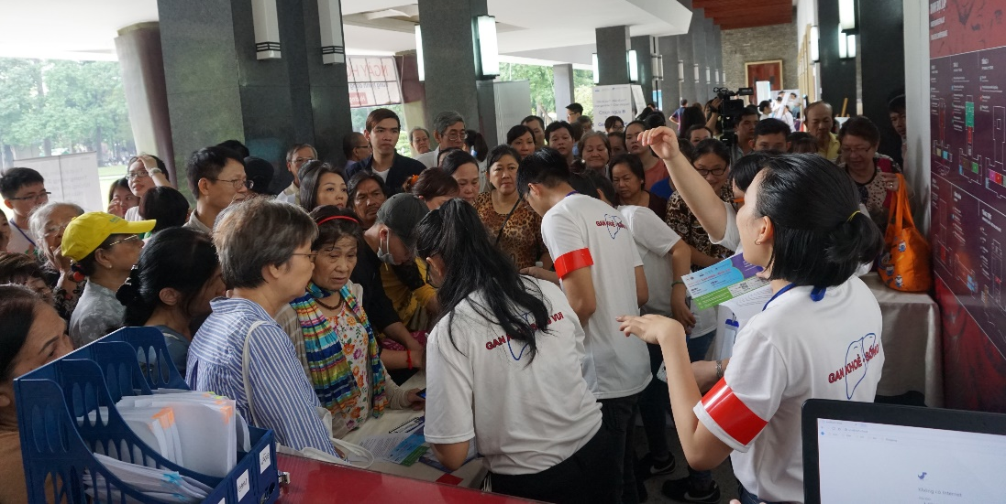
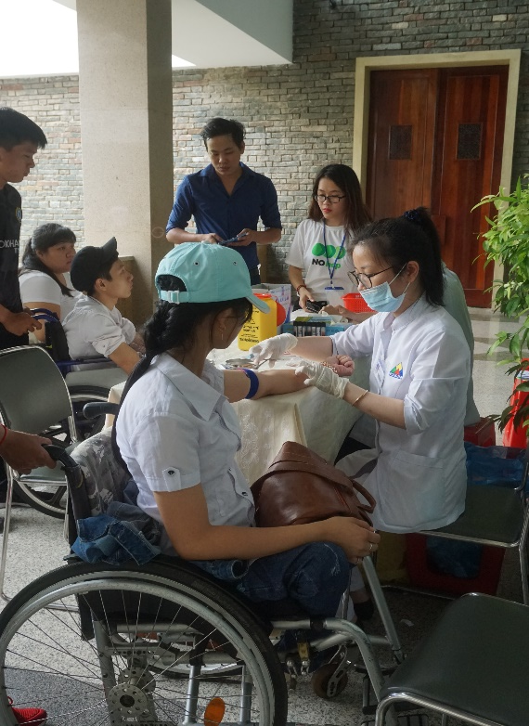
July 28, 2018 - World Hepatitis Day at the Reunification Palace (formerly Independence Palace)
Community Education Seminar for Patients
Community Screening for 2,000 Individuals

Slide 11
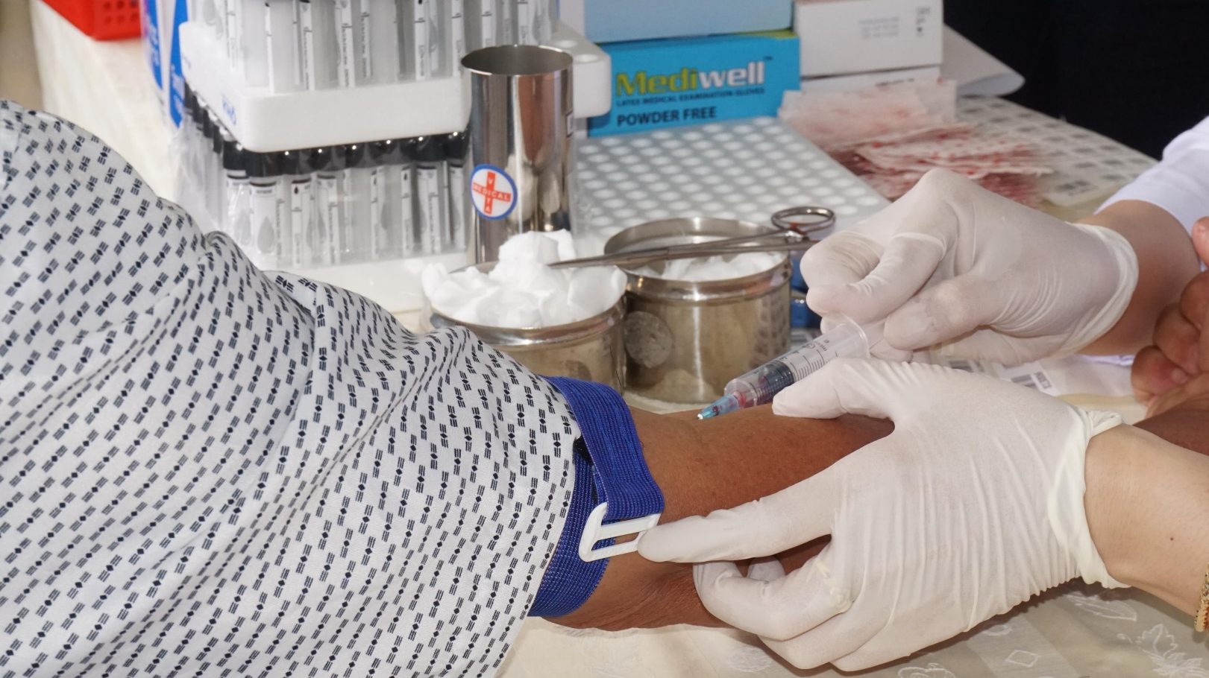
C.H.I.M.E. for Vietnam Project
Project Year(s): 2019 - 2020
Project goal: Conquering Hepatitis via Micro-Elimination for Vietnam (C.H.I.M.E.) for Vietnam’s goal is to screen and provide access to care program for a representative sample of 20,000 residents in Ho Chi Minh City (HCMC), Vietnam. Particularly, V-VHA emphasizes on further expanding and rigorously evaluating our linkage to care model for viral hepatitis in HCMC.
Project outcomes:
20,000 individuals screened in HCMC
7.6% HBV positive
1.92% HCV positive
Linked positive patients to care and treatment services

Slide 12
HBV-HCV Linkage to Care and Treatment Pathways for Access to Hepatitis Treatment (P.A.T.H.) to Cure in Vietnam Program
Program Goal: Link and cure patients who test positive to hepatitis B (HBV) and/or hepatitis C (HCV)
Program Objectives:
To provide patient navigation services, including guidance and strategies to claim insurance coverage for at least 1,000 HBV and/or HCV positive patients to ensure access to care through V-VHA’s referral network and other partnering community healthcare providers in HCMC.
To provide patients with liver health education seminars with culturally appropriate material on viral hepatitis and liver cancer education.

Slide 13
Cascade of Care Results
Total number of patients screened: 22,447 (from 2016 to 2020)
Total number of patients on study: 17,873
Total number of patients tested positive for HBV: 1,441 (8.06%)
Total number of HBV patients who have agreed to seek care / treatment services: 448 (60.21%)
Total number of HBV patients who have been assisted with financial guidance: 267 (44.87%)
Total number of patients tested positive HCV: 432 (1.92%)
Confirmed RNA: 150 (69.4%)
Confirmed RNA+: 75 (50%)
Total number of HCV patients who have agreed to seek care / treatment services: 34 (45%)
Total number of HCV patients who have been assisted with financial guidance: 38 (51%)

Slide 14
Screening / Diagnostic costs
HBV:
POC cost: $1.30 USD
Screening test covered in health insurance? NO
Patient co-pays (if insured) for HBV treatment (80%) for a treatment course ($450 - $750 USD/year; depending on generic or DDAs)
HBV vaccination series: $25USD
HCV:
POC (RDT) cost: $1.30 USD (not widely used in community)
HCV PCR cost: $23USD (no PCR POC availability)
Screening test covered in health insurance? NO
Patient co-pays (if insured) for HCV treatment (50%) for a treatment course ($1,200 - $1,500 USD)
Note: Estimated costs for V-VHA includes discounts offered by strategic partners.

Slide 15
Current challenges
Funding for HBV-HCV testing scale-up in Vietnam (Operations Cost)
Program Manager Salary (1FTE): $2,000 USD/mo.
Project Coordinator / Office Manager Salary (1FTE): $1,000 USD/mo.
Social Worker / Outreach Staff (1FTE): $500 USD/mo. x 3 staff members
Indirect cost (rent, utilities, telecommunication, etc.): $800 USD/mo.
Impact of COVID-19
Community screenings have been affected
In-person meetings have been affected

Slide 16
Next step for HBV-HCV testing scale-up: Hepatitis Evaluation to Amplify Testing and Treatment (H.E.A.T.) in Vietnam Program
Project year(s): 2020 – 2021
Goal:
Hepatitis Evaluation to Amplify Testing and Treatment (H.E.A.T.) in Vietnam is a project funded by the Coalition of Global Hepatitis Elimination at the Task Force for Global Health. Under the guidance of a coalition of local stakeholders, V-VHA has been coordinating the support of expanded HBV and HCV testing and treatment efforts in Vietnam to focus on the two objectives below.
Program Objective #1: Identify feasible strategies to scale testing and proven models of care.
Progress: V-VHA has identified partners and began individual (in-person) preliminary discussion in late November / early December 2020. More needs to be done on data collection from partners.
Program Objective #2: Developing policy recommendations to inform further program development.
Progress: V-VHA will begin this discussion with partners in Spring 2021 after the completion of the data collection.
Expected Outcome:
Public private partnership to implement public health policies that address the burden of viral hepatitis in Vietnam and work towards an viral hepatitis elimination by 2030.

